Slide 1
Correlation
Dr. Basharat Mahmood
Department of Computer Science, COMSATS University Islamabad.

Slide 2
Outline
Introduction to Correlation
Pearson’s correlation coefficient
Coefficient of Determination r²
Statistical significance of r

Slide 3
1. Introduction to Correlation
Is there an association between:
Number of study hours and marks in exam
Children’s IQ and Parents’ IQ
Degree of social trust and number of membership in voluntary association ?
Urban growth and air quality violations?
Number of police patrol and number of crime
The word correlation is used in everyday life to denote some form of association.

Slide 4
1. Introduction to Correlation …
Correlation coefficient: statistical index of the degree to which two variables are associated, or related.
We can determine whether one variable is related to another by seeing whether scores on the two variables covary---whether they vary together.
Correlation measures association by measuring; how when one variable changes other changes with it, which means it is measuring dynamic relationships (change).

Slide 5
1. Introduction to Correlation …
Scatterplot
The relationship between any two variables can be portrayed graphically on an x- and y- axis.
Each subject i₁ has (x_{1,} y₁₎. When score s for an entire sample are plotted, the result is called scatter plot.

Slide 6
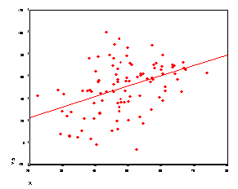
1. Introduction to Correlation …

Slide 7
1. Introduction to Correlation …
Direction of the relationship
Variables can be positively or negatively correlated.
Positive correlation: A value of one variable increase, value of other variable increase.
Negative correlation: A value of one variable increase, value of other variable decrease.

Slide 8
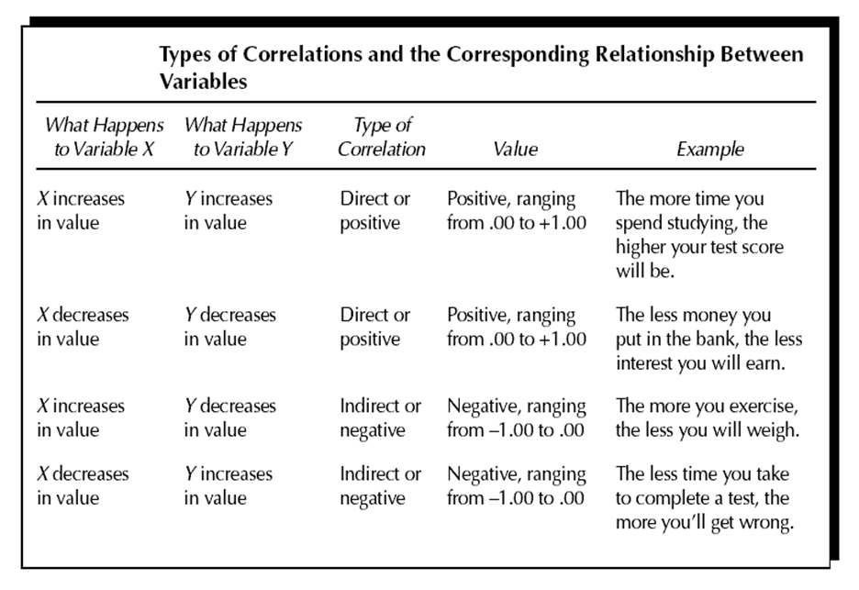
1. Introduction to Correlation …

Slide 9


Slide 10
1. Introduction to Correlation …
Strength of the relationship
The magnitude of correlation:
Indicated by its numerical value
ignoring the sign
expresses the strength of the linear relationship between the variables.

Slide 11
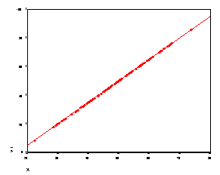
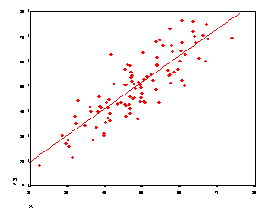
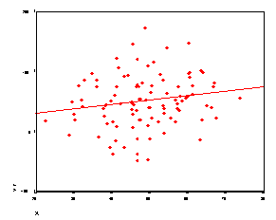
r =1.00
r = .42
r =.17
r =.85

Slide 12
1. Introduction to Correlation …
Size of correlation coefficient | General Interpretation
.8 - 1.0 | Very Strong
.6 - .8 | Strong
.4 - .6 | Moderate
.2 - .4 | Weak
.0 - .2 | Very Weak or no relationship

Slide 13
2. Pearson’s correlation coefficient
There are many kinds of correlation coefficients, but the most commonly used measure of correlation is the Pearson’s correlation coefficient. (r)
The Pearson r range between -1 to +1.
Sign indicate the direction.
The numerical value indicates the strength.
Perfect correlation : -1 or 1
No correlation: 0
A correlation of zero indicates the value are not linearly related.

Slide 14
2. Pearson’s correlation coefficient…
The Pearson r can be thought of as a standardized measure of the association between two variables.
That is, a correlation between two variables equal to .64 is the same strength of relationship as the correlation of .64 for two entirely different variables.

Slide 15
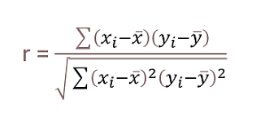
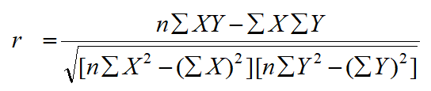
2. Pearson’s correlation coefficient…

Slide 16
2. Pearson’s correlation coefficient…
Example 1: Compute and interpret the correlation coefficient for the following grades of 6 students selected at random:
Mathematics grade 70 92 80 74 65 83
English grade 74 84 63 87 78 90

Slide 17
3. Coefficient of Determination r²
Expresses the proportion of the total variation in the values of the variable Y that can be accounted for or explained by a linear relationship with the values of the random variable X.

Slide 18


Point-Biserial Correlation
This method is specifically designed to find the correlation between a binary variable and a continuous variable.
Group the values based on values of binary variable
M1​ = Mean of the continuous variable for the group with the binary variable equal to 1.
𝑀0 = Mean of the continuous variable for the group with the binary variable equal to 0.
Sn= Standard Deviation of the continuous variable

Slide 19
4. Statistical significance of r
A correlation coefficient calculated on a sample is statistically significant if it has a very probability of being zero in the population.
In other words, to test r for significance, we test the null hypothesis that, in the population the correlation is zero by computing a t statistic.

Slide 20


4. Statistical significance of r

Slide 21
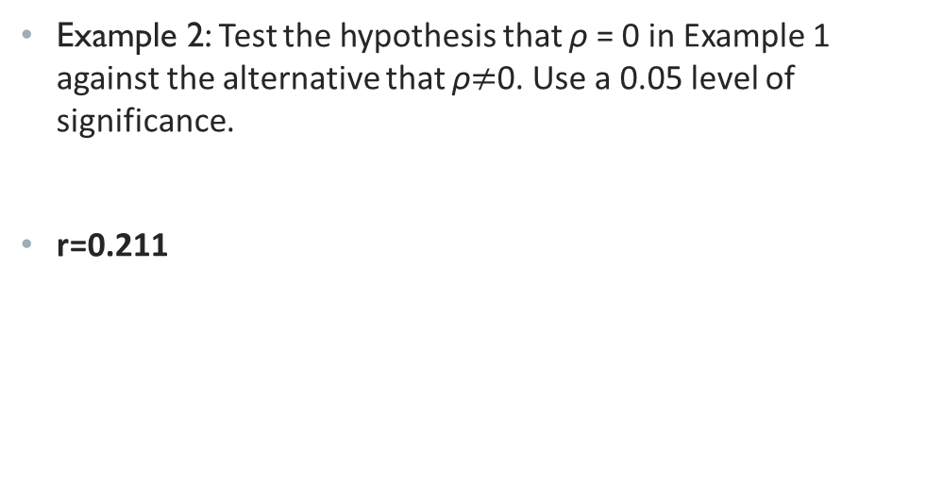
4. Statistical significance of r…
Example 2: Test the hypothesis that ρ = 0 in Example 1 against the alternative that ρ$≠$0. Use a 0.05 level of significance.
r=0.211

Slide 22
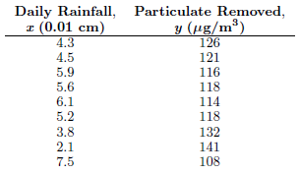
4. Statistical significance of r…
Example 3: A study of the amount of rainfall and the quantity of air pollution removed produced the data given in table. (assume a bivariate normal distribution for x and y)
Calculate r
Test the null hypothesis that ρ = −0.5 against the alternative that ρ < −0.5 at the 0.025 level of significance
Determine the percentage of the variation in the amount of particulate removed that is due to changes in the daily amount of rainfall
r=-0.979

Slide 23
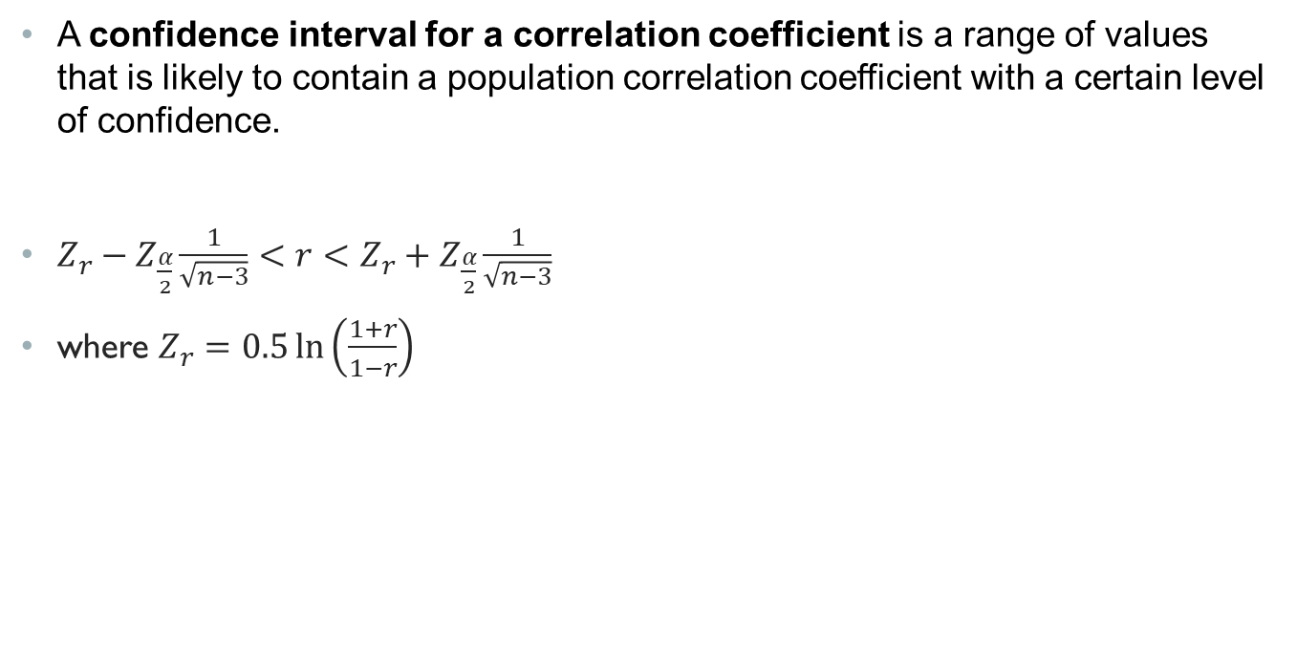
Confidence interval for population correlation coefficient
A confidence interval for a correlation coefficient is a range of values that is likely to contain a population correlation coefficient with a certain level of confidence.
$Z_{r}−Z_{\frac{α}{2}}\frac{1}{\sqrt{n−3}}<r<$ $Z_{r}+Z_{\frac{α}{2}}\frac{1}{\sqrt{n−3}}$
where $Z_{r}=0.5\ln\left(\frac{1+r}{1−r}\right)$

Slide 24
Correlation analysis in python
Scatter plot:
seaborn.scatterplot(data=None, *, x=None, y=None, hue=None, size=None, style=None, palette=None, hue_order=None, hue_norm=None, sizes=None, size_order=None, size_norm=None, markers=True, style_order=None, legend='auto', ax=None, **kwargs)
Example:
sp =seaborn.scatterplot(x=“x-col”, y=“y-col”, data = df)
sp.set_title(‘Title’)
seaborn.lmplot((x=“x-col”, y=“y-col”, data = df)

Slide 25
Correlation analysis in python
Pearson r coefficient:
df.corr() // correlation coefficient matrix
sns.heatmap(df.corr()) // heatmap
from scipy import stats
stats.pearsonr(df[‘x’],df[‘y’])

